Slide 1


Convolutional
Neural Networks
♦ Wayne Fincher ♦
♦ Priyanka Vyas ♦
Notes:
Hi. I’m Wayne and I’m here with Priyanka. Our presentation is covering applications of convolutional neural networks.

Slide 2
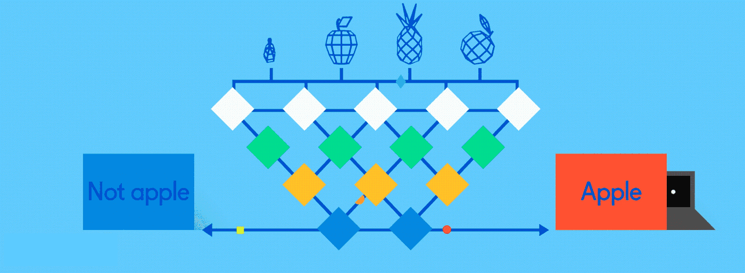
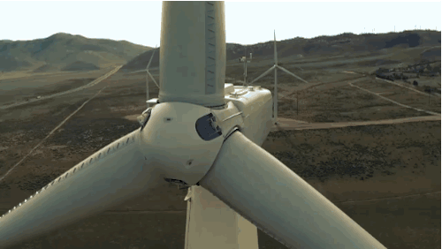
Application Areas Studied
Apple Harvesting
Wind power prediction based on CNN
Notes:
I will be discussing an application of convolutional neural networks in automated robotic apple picking using computer vision and a technique called mask r-cnn.
Wind Power Prediction based CNN
The Application that I have chosen is Wind Power Prediction based on CNN. The world today is facing an emerging energy crisis and to mitigate this crisis there is a need for a model to predict the wind power and control the uncertain output.

Slide 3

Fundamentals of CNN:
Notes:
We will just briefly mention the basics of CNN since Prof. Bansal has covered it previously.
The classic input to a cnn is an image. But any data can be input to a 2d cnn when shaped properly. One or more filters will slide over the image computing a feature map for each filter. A pooling layer is typically added after the convolution layer which provides a certain amount of translation and rotation invariance.
A Convolutional Neural Network takes in an input image, assign learnable weights and biases to various objects in the image and differentiates one from the other. A CNN successfully capture the Spatial-Temporal dependencies in an image through the application of relevant filters. It reduces the images into a form which is easier to process, without losing features which are critical for getting a good prediction. As seen in slide the image is processed through filters for feature extraction and is flatten to derive an output using an activation function respectively.

Slide 4
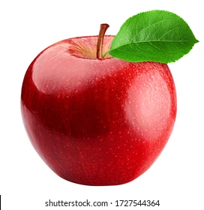

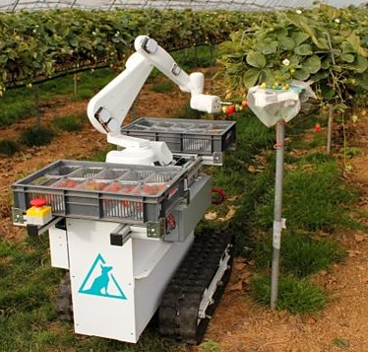



Apple Harvesting
Complex backgrounds
Occlusion of apples
Problems to solve:
Fluctuating illumination
Image masking
Notes:
In the agriculture industry, there is a substantial cost arising from manual labor. The cost is not just the wages but is also realized in the form of managerial requirements as well as the risk from liability. This motivates the development of automated robotic systems that incorporate computer vision which is able to identify the location of produce and allows the robot to harvest it. In this particular case, we are considering robotic systems used in apple orchards. The problems encountered with identifying apples on a tree are complex backgrounds, fluctuating illumination, and occlusion of apples either by other apples, branches, or leaves. Additionally, the computer software needs to be able to precisely locate the apple so that the apple will be successfully picked.

Slide 5
Backbone
ResNet
Layer 4
Avoids vanishing gradient
Prevents accuracy saturation
Layer 3
Layer 2
Layer 1
Notes:
To achieve these goals, a state of the art mask-region convolutional neural network is utilized. The network begins with a so called “backbone” that produces an initial set of feature images. In the past, a ResNet was used, which has the benefit of avoiding the vanishing gradient problem and prevents accuracy saturation.
—------------------------------------------------
Why ResNet:
“ResNet effectively solved this difficult by using multiple layers with parameter to learn the representation of residuals between inputs and outputs, and significantly improve the training speed and prediction accuracy of the deep network.” Jia - Computers and Electronics in Agriculture
Why accuracy saturation:
“When deeper networks are able to start converging, a degradation problem has been exposed: with the network depth increasing, accuracy gets saturated (which might be unsurprising) and then degrades rapidly. Unexpectedly, such degradation is not caused by overfitting, and adding more layers to a suitably deep model leads to higher training error, as reported in [blah, and blah] and thoroughly verified by our experiments.” Kaiming He – Deep Residual Learning for Image Recognition

Slide 6
Backbone
DenseNet
Layer 4
Avoids vanishing gradient
Strengthens feature propagation
Encourages feature reuse
Uses less parameters
Layer 3
Layer 2
Layer 1
Notes:
Another variation on the backbone is using a DenseNet. This also avoids the vanishing gradient problem and has the additional benefits of strengthening feature propagation, encouraging feature reuse, and using less parameters than ResNet.
—----------------------------------------------------
Why less parameters:
“DenseNet architecture explicitly differentiates between information that is added to the network and information that is preserved. DenseNet layers are very narrow (e.g., 12 filters per layer), adding only a small set of feature-maps to the “collective knowledge” of the network and keep the remaining featuremaps unchanged—and the final classifier makes a decision based on all feature-maps in the network.” Huang - Densely Connected Convolutional Networks
How many parameters?
https://keras.io/api/applications/#usage-examples-for-image-classification-models

Slide 7
Backbone
ResNet + DenseNet
Output
Layer 4
Concat, 1x1 Conv
Avoids vanishing gradient
Better feature propagation
Encourages feature reuse
Increased performance
Layer 3
3x3 Conv, ReLU
Layer 2
3x3 Conv, ReLU
Layer 1
3x3 Conv, ReLU
Input
Notes:
The novel approach in this work is combining ResNet and DenseNet to reap most of the benefits of each individual network.
—-----------------------------------------------------------------
Structure of residual dense block:
3x3 Conv, ReLU
3x3 Conv, ReLU
3x3 Conv, ReLU
Concat, 1x1 Conv

Slide 8
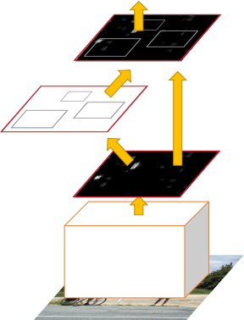
RPN
Region Proposal Network
RoI align
Region proposals
Features
Identifies regions of interest
Assigns “objectness” score
Backbone
Notes:
After the backbone has generated a set of feature maps, those maps are fed into the region proposal network which aims to accomplish two tasks: it will produce bounding boxes around regions of interest and it assigns a so called “objectness” score to each region of interest indicating its likelihood that the region contains an apple.
—------------------------------------------------------------------
What is RPN?
“A Region Proposal Network (RPN) takes an image (of any size) as input and outputs a set of rectangular object proposals, each with an objectness score.” Ren – Faster R-CNN: Towards Real-Time Object Detection with Region Proposal Networks
What size input for an FCN?
“An FCN naturally operates on an input of any size, and produces an output of corresponding (possibly resampled) spatial dimensions.” Long – Fully Convolutional Networks for Semantic Segmentation

Slide 9
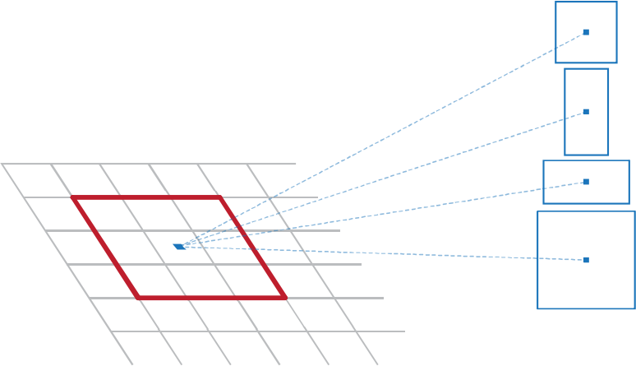
RPN
Region Proposal Network
Parallel 1x1
FCN layers
1x1
Object
1x1
Box
9 bounding
boxes/pixel
Notes:
For each pixel of each feature map, a set of nine bounding boxes of various sizes is generated. The regions bound by the boxes are fed into two parallel 1x1 convolution layers. The 1x1 object convolution layer computes the objectness score for that region. The 1x1 box convolution layer is used to decrease the size of the bounding box.
—--------------------------------------
What size boxes?
3 different area scales including 16 * 16, 64 * 64, and 128 * 128, and 3 aspect ratios as 1:1, 1:2, 2:1

Slide 10
RPN
Region Proposal Network
Features
9 bounding boxes/pixel
Bounding box sizes are randomly selected from the following set of dimensions: {16 * 16, 64 * 64, 128 * 128} and ratios: {1:1, 1:2,
2:1}.
Since there are only 9 combinations of the above sets and the pool of 9 randomly selected bounding box sizes will often have duplicate combinations of dimensions and ratios, I would assume that the anchor position within the bounding box would also be randomized. The paper does not say if this is the case or not.
Normalization?
The Region Proposal Network is said to be a fully convolutional network which omits any deeply connected layer. The paper seems to indicate that the features corresponding to those bounding boxes are fed directly into the 1x1 Object and 1x1 Box layers.
Notes:
For each pixel of each feature map, a set of nine bounding boxes of various sizes is generated. The regions bound by the boxes are fed into two parallel 1x1 convolution layers. The 1x1 object convolution layer computes the objectness score for that region. The 1x1 box convolution layer is used to decrease the size of the bounding box.
—--------------------------------------
What size boxes?
3 different area scales including 16 * 16, 64 * 64, and 128 * 128, and 3 aspect ratios as 1:1, 1:2, 2:1

Slide 11
RPN
Region Proposal Network
Features
Quote from Weikuan Jia, Yuyu Tiana, Rong Luob, Zhonghua Zhanga, Jian Lianc, Yuanjie Zheng (Detection and segmentation of overlapped fruits based on optimized mask R-CNN application in apple harvesting robot) “The application of RPN only makes the extra cost of a two layer network”
9 features in
Parallel 1x1
FCN layers
1x1 Object
Softmax
1x1 Box
Regression
4x9 set of bounding box coordinates out
2x9 set of “object-
ness” scores out
Notes:
For each pixel of each feature map, a set of nine bounding boxes of various sizes is generated. The regions bound by the boxes are fed into two parallel 1x1 convolution layers. The 1x1 object convolution layer computes the objectness score for that region. The 1x1 box convolution layer is used to decrease the size of the bounding box.
—--------------------------------------
What size boxes?
3 different area scales including 16 * 16, 64 * 64, and 128 * 128, and 3 aspect ratios as 1:1, 1:2, 2:1

Slide 12
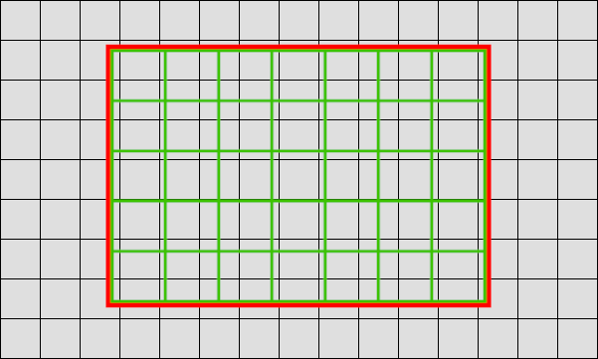
RoI Align
Scale and translate feature map w/region proposals to fit the original image’s pixel grid.
Original image pixel grid
Feature map
Region proposal
Notes:
Since the size and location specified by those bounding boxes are no longer aligned correctly with the original image, the RoI Align layer adjust the bounding box coordinates and resizes the features to realign them.

Slide 13
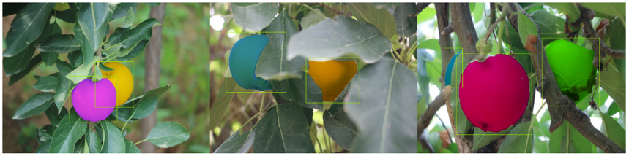
Object Mask
Aligned RoI
FCN
1x1 Conv
Notes:
Now that the features and bounding boxes are aligned with the image, a fully convolutional network is used to generate the object masks for those regions which have a sufficient objectness score. A fully convolutional network (or FCN) is a network that does not have any dense layers. An FCN is required because the dense layers have a specified input size and the bounding boxes are not of any specific size. A convolution layer, on the other hand, is able to accommodate arbitrarily sized inputs. The final output of this portion of the network is a binary value which specifies if the pixel is masked or not.

Slide 14
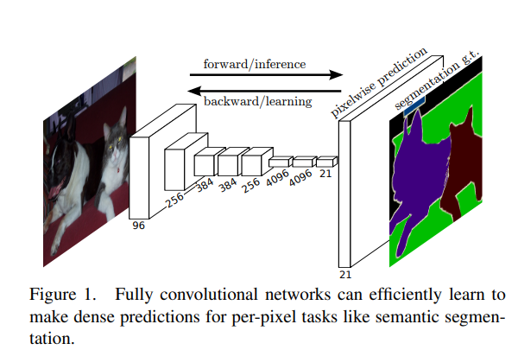
Object Mask
Features
According to Jonathan Long, Evan Shelhamer, Trevor Darrell in the paper Fully Convolutional Networks for Semantic Segmentation, they gave the structure of the FCN as:
FCN
1x1 Conv
In Weikuan Jia, Yuyu Tiana, Rong Luob, Zhonghua Zhanga, Jian Lianc, Yuanjie Zheng (Detection and segmentation of overlapped fruits based on optimized mask R-CNN application in apple harvesting robot), the structure of the FCN for the Object Mask is not given.
Notes:
Now that the features and bounding boxes are aligned with the image, a fully convolutional network is used to generate the object masks for those regions which have a sufficient objectness score. A fully convolutional network (or FCN) is a network that does not have any dense layers. An FCN is required because the dense layers have a specified input size and the bounding boxes are not of any specific size. A convolution layer, on the other hand, is able to accommodate arbitrarily sized inputs. The final output of this portion of the network is a binary value which specifies if the pixel is masked or not.

Slide 15

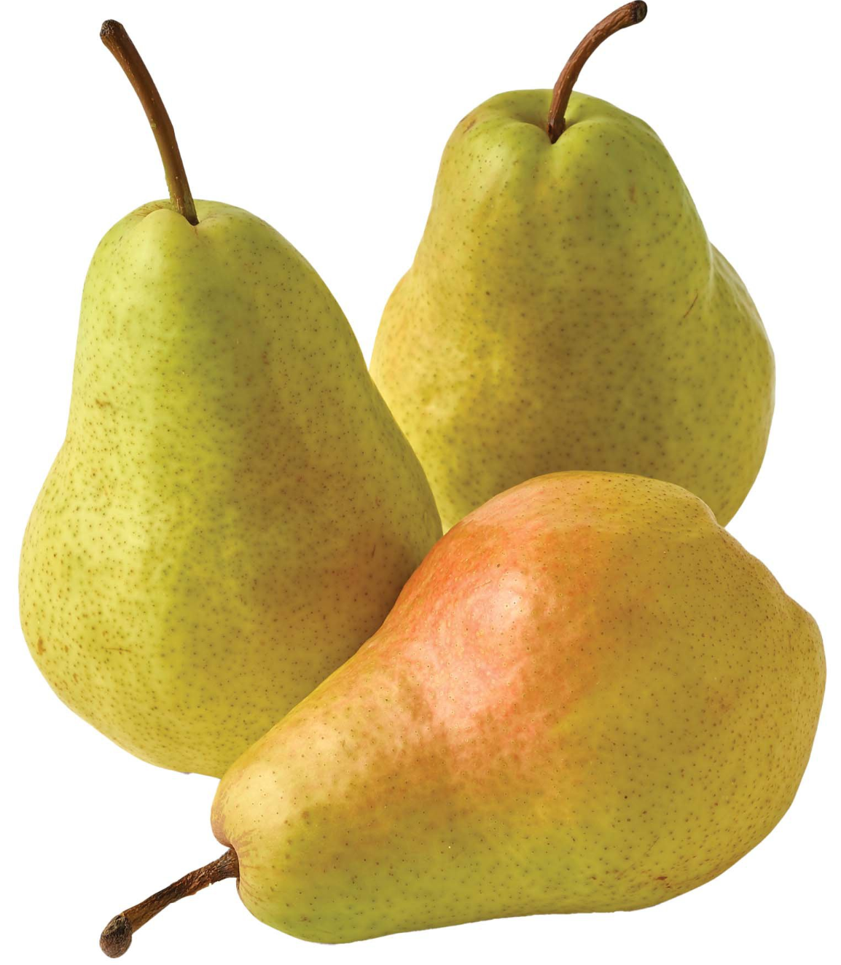

Critique
Requires curated images with RoIs which are masked.
Different fruits require training with images of those particular fruits.
Notes:
The training process does require a dataset with the regions containing apples that are marked by hand. The limited set of labeled images reduces the effectiveness of the training, and increasing the size of the labeled set would be labor intensive. This problem could be mitigated by using an unsupervised training method, perhaps with an actual robot that tries to pick apples from the proposed locations.
Another issue is that the trained network only works with one type of fruit. The network trained on images of apples would not have success picking pears.

Slide 16
Wind Power Prediction based on CNN
WPP w/CNN
Problem Specification:
Uncertain power output due to meteorological condition.
Irregularities in power system operation.
Quality of power supply is impacted
Proposed solution:
Consider discrete power data samples as signals.
Predict short term Wind Power prediction based on CNN and Hybrid Model
Notes:
Wind power is majorly affected by meteorological conditions resulting into power output uncertainty. This uncertainty in turn affects the quality of power system operations like distribution, peak load management etc. When large scale wind farms are connected to the power grid wind power has significant impact on periodic operations due to high unpredictability.
The solution proposed in this paper is to predict the wind power based on CNN model, the wind power prediction would help in improving the operation scheduling of power systems and also in optimizing the operating schedule for backup generators and storage systems.

Slide 17
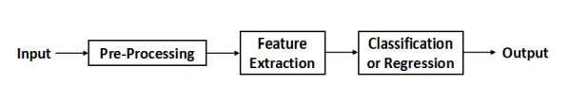
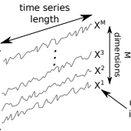
Training Approach for WPP w/CNN
WPP w/CNN
Basic CNN Structure
1
2
3
Input Layer
Hidden Layer
Output Layer
Historical Power Data
Convolution
Pooling
Fully Connected
BP algorithm
Sigmoid function
MSE
Ref. paper Anwen Zhu et al.
Notes:
To train the model historical data of a wind farm is used as an input and this data is pre-processed from 1-dimensional array of data into 2-dimension matrix.
For feature extraction, the network process information in forward direction, gathers features through convolution and pooling layers and optimizes the network structure using back propagation technique.
Each hidden layer’s neuron are only connected to a portion of the input layer’s neuron so all the convolution filters act repeatedly on the receptive fields, extracting the local features using convolutional kernels. The final output is a feature map of the input and that is the required prediction result i.e. the time series value.

Slide 18
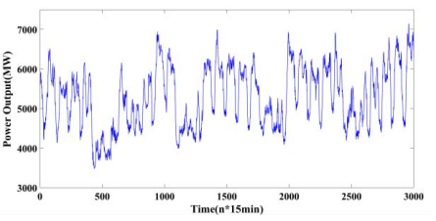
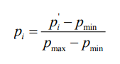
Architecture for WPP w/CNN
WPP w/CNN
1
Feature Learning:
Historical power data (2yrs)-1D sequences of data
Input variables are normalised by reshaping the data in MATLAB.
1D array is reshaped to 2D matrix for CNN input
Sliding window sampling (15min) at y(t) for input selection.
Length of Time Series(T)=30000
Input:One line of data (20*20) i.e. 400 data points
Train network using property and response file i.e.A scale range of power data.
Input Layer
Feature normalization equation
Ref. paper Anwen Zhu et al.

Slide 19
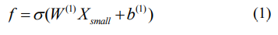
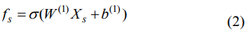
Architecture for WPP w/CNN
WPP w/CNN
2
Hidden Layer
Feature Extraction:
Convolution,Pooling extracts spatial features.
Two layers: 2D Convolution, 2D Max. Pooling
Filters acts as Pattern Detector in CNN
Convolution Operation:2 Filters, kernel size:5
-C1: Filter size: 6*16*16
-C2: Filter size: 12*4*4
Feature map down-sampling through Max. Pooling: Reduces dimension of Feature map. Scale size:2
-S1:6*8*8
-S2: 12*2*2
BP Algorithm to tune kernel weights.
Bias is added to output of convolution and then passed through an activation function i.e. sigmoid.
Each Filter here detect a scale range and an output of one layer is input for next layer
Convolution Operation eq:
Ref. paper Anwen Zhu et al.
Notes:
For mapping parameters, Lets quickly understand how does the convolution and pooling filters work for Time Series Classification:
To derive a convolved feature each neuron has one or more input values and every input value is associated to a weight. The goal of a neuron is to compute the weighted sum of the input values and then apply an activation function to the result. Here the activation function is sigmoid, which establishes a complex functional relationship between predicted value and the spatial-temporal characteristics of historical wind data.
As explained by author, for an image the input dimension is 5×5, and the kernel (filter) size is 3x3. That is, each low-resolution image with a size of 3×3 gets 1 feature.. After the convolution, the size of the feature matrix is 3×3. i.e. the convolved feature. Then for 8x8 convolved feature the scale/stride chosen is 2 which is input to a pooling layer and the number of features decreases to 4x4 after pooling.
Parameters for CNN.
So here for a map size of an input sample is 20×20 window. The kernel/filter size is 5x5 with no padding and scale/stride 1.
The first convolution layer C1 (input, weights) consists of 6 filters, the map sizes of which are 20 – 5 + 1 = 16. So the output shape is (6*16*16) and number of filters is 6.
The first pooling layer S1 also consists of 6 filters, the map sizes of which are 16 / 2 = 8 with stride 2. Therefore the output shape is (6*8*8)
The second convolution layer C2 consists of 12 feature maps, the map sizes of which are 8 – 5 + 1 = 4, the output shape is (12*4*4)
The second pooling layer S2 also consists of 12 feature maps, the map sizes of which are 4 / 2 = 2. The 12 × 2 × 2 = 48 features are put in order, and 10 output data points are obtained.

Slide 20
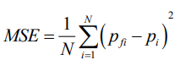
Architecture for WPP w/CNN
WPP w/CNN
3
Model Result:
Normalise power data of each mini-batch through equation ‘p_{i’} for input to layers in NN.
Classifier: Scale data to the range of Sigmoid function.
Learns relationship between learned feature and sample classes. Feature Map: 16
Match the scale of output variable with scale of activation function for output training and testing.
Output is a real value y(t+4) hours
Calculate MSE to compare predicted value v/s actual value and determine approach feasibility.
Output Layer
Feature normalization equation
Accuracy evaluation indicator
Ref. paper Anwen Zhu et al.
Notes:
The parameters are as follows
Original Time series historical data from a wind farm that was recorded every 15 min for 2 years is used in this paper as an CNN input and MATLAB was used to run the approach.
To standardize the input to layers in the network for each mini-batch, the batch normalization of wind power value is done using equation as given in slide.
Property file is used as an input of CNN which has 400 data in each line, i.e. a matrix size of 20*20. It means 400 inputs that are a continuous sequence of sampling every 15 minutes. During training 400 properties of each sample undergoes convolution and pooling process twice, then the perceptron in the last layer gets 16 output.
Response file i.e expected output value is used to compare the prediction result which has 16 data in each line. The difference between the 16 outputs of CNN and corresponding 16 sample response file is calculated. The Back propagation technique is used to calculate error and tune the networks weight to achieve a better prediction accuracy
A Sample size of 30000 is used to train the model, so the training sample size for the model is 20*20*30000 matrix.
1000 samples are used to Test the CNN model.
Accuracy evaluation indicator (MSE) is calculate to compare the actual value to predicted value and the result shows that the evaluated indicator MSE = 0.00076 and the predicted and actual value coincides. This shows CNN can to applied for Wind power prediction.

Slide 21
Model Training and Testing for WPP w/CNN
WPP w/CNN
Data pre-processing for normalization
Obtain weights and bias from sample lines.
Train the CNN model using sigmoid function.
Compare training samples with response values for testing.
Apply Back-propagation algorithm to calculate and transfer error of the neural network.
Utilize gradient to obtain weight modifier.
Continue training model until the error reaches expected value
Calculate MSE to validate the model prediction.
Ref. paper Anwen Zhu et al.
Notes:
We will implement the approach discussed in last slides to train and test the model:
Pre-process the data from 1 Dimensional array of data to: 2D matrix for CNN input
Property and Response files are used as sample files and to obtain weights and bias to train the model.
Sigmoid function is the activation function used in this research paper to establish a functional relationship between the predicted value and the spatial-temporal characteristic of historical wind data.
Compare training samples with response values to derive prediction value.
Apply Back-Propagation algorithm to calculate and transfer error of the neural network
Utilize gradient to obtain weight modifier.
Continue training model until the error reaches expected value i.e. Accuracy evaluation indicator- MSE.

Slide 22
Issues and Limitations for WPP w/CNN
WPP w/CNN
Prediction is short term i.e. 4 hrs
Focus is on univariate wind power prediction technique.
Wind power is a random variable having a Probability Density Function.
WPP leading to changes in power losses in the grid.
Limited data being used for WPP
Ref. paper Anwen Zhu et al.
Notes:
Issue and Limitation:
Prediction is short term i.e. 4 hrs
Focus is on univariate wind power prediction technique.
Wind power is a random variable having a Probability Density Function.
WPP leading to changes in power losses in the grid.
Limited data being used for WPP.

Slide 23
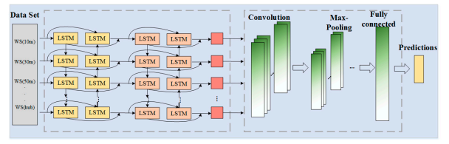
Critique for WPP w/CNN
WPP w/CNN
Higher chances of error in long term prediction.
Feasibility to use Pytorch rather than MATLAB.
Feasibility to use NWP data as input simultaneously.
Propose Hybrid BiLSTM-CNN approach for WPP for better prediction accuracy. Ref. paper by Zhen Hao et al.
Notes:
Critique for WPP w/CNN
Historical Power output data is used to predict future power output for a short term.
Long term prediction of wind power is not feasible using single CNN model approach.
There is higher chance of error in adopted long term prediction approach as a vanishing gradient might lead to inaccuracy.
Proposed model in the paper uses a univariate data. A Feasibility to use NWP data as input simultaneously could enhance the model accuracy.
By Propose Hybrid BiLSTM-CNN approach for WPP for could improve the prediction accuracy. But, a multivariate time series as an input doesn't work well for Time Series Classification because the length of the time series really hurts the computational speed. Hence, using multi-layer perceptron for Time Series Classification isn't a novel solution.
Referring the figure in slide, and paper by Zhen Hao et al, where a Bi-LSTM model is used to extract bidirectional temporal characteristics and the convolution and pooling operations of CNN is used to extract the spatial characteristics from a multiple input historical time series wind data.
This model combines the forward and backward information of the input sequence on the basis of LSTM and the original data used in this paper constitutes historical wind power output, wind speed and wind direction with different hub heights, relative humidity, rainfall and pressure. For data correlation Grey Correlation Analysis is used to screen the input based on correlation form original data. The temporal resolution of data set considered was 5 min.
Here Bi-LSTM-CNN model has two hidden layer with 64 and 128 neurons respectively. Two sets of convolution and pooling layers are used to learn spatial features among the output of Bi-LSTM. Kernel size used in convolution layers is 3*3. The batch size of model is 100. The predicted output value is achieved through a fully connected output layer with 512 neurons.
MSE is the accuracy evaluation indicator used in this paper and the result showed that Bi-LSTM-CNN model gave higher prediction accuracy as compared to single CNN model as the inherent storage unit and gate mechanism of LSTM effectively saves the event in time series and past information is also effectively used in for prediction but since the hybrid model (like BiLSTM-CNN) has more parameters in prediction process, it relatively lowers the computational speed.

Slide 24
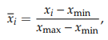
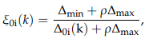
Architecture for WPP w/BiLSTM-CNN
WPP w/BiLSTM-CNN
1
Input Layer
Feature Learning:
Input: Multivariate (NWP, power data)
Input selection: Grey Correlation Analysis
Calculate reference and comparison sequence for Wind data
Standardize sequence using average and difference normalization for matrix transformation.
Calculate Absolute Value difference
Calculate the discrete coefficients that shows degree of correlation.
Calculate average of gray correlation.
Input data sample size: 4896
Temporal resolution of data: 5min
Batch size:100
Feature normalization equation
Calculate degree of correlation
Ref. paper Zhen Hao et al.

Slide 25
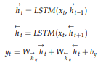
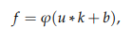
Architecture for WPP w/BiLSTM-CNN
WPP w/BiLSTM-CNN
2
Hidden Layer
Feature Extraction:
BiLSTM-extract bidirectional temporal features
Convolution-Pooling- extract spatial features
Data extracted from BiLSTM is input for CNN.
2 Convolution and 2 Pooling layer used for extraction with Kernel size 3
Hidden layer has 64 and 128 neurons
Add Drop out mechanism(2 layer)to prevent overfitting
FC layer has 512 neurons to predict the output
Indicator used to verify prediction accuracy is MSE.
BiLSTM operation eq:
Convolution operation eq:
Ref. paper Zhen Hao et al.

Slide 26
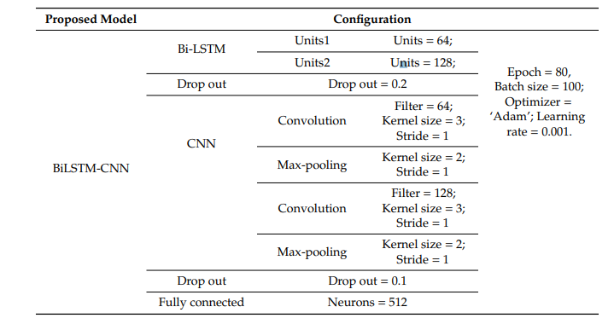
Architecture for WPP w/BiLSTM-CNN
WPP w/BiLSTM-CNN
3
Output Layer
Parameters
Model Result:
Best Accuracy with low MSE value compared to single CNN model.
Apply Adam Optimizer to identify learning Rate
Ref. paper Zhen Hao et al.

Slide 27
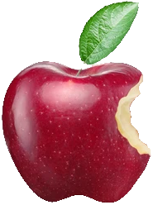

Conclusion
Mask R-CNN:
Pixel level masks instead of rectangular masks
Not hindered by occlusion
High accuracy of 96% to 97%
Increases profits for farmers
Lowers prices for consumers
Notes:
Using Mask R-CNN, we created pixel level masks to precisely locate apples to pick. This process was not hindered by occlusion from other apples, leaves, or branches. The success rate of >= 96% makes this technique feasible for use in the field. When deployed, this automated apple picking system will increase profits for farmers and lower prices for consumers.

Slide 28
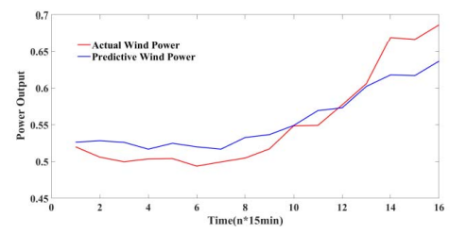
Conclusion - WPP w/CNN
Wind Power Prediction
Red curve is the actual wind power and blue curve is the predictive value.
The predicted and actual value coincide in the result, verifying feasibility of application.
Model gives prediction for wind power in proceeding 4 hours.
Accurate prediction helps in system cost curtailment.
Demand side strategies can be developed to fulfill growing energy demand in economical way.
CNN has fastest computational speed, less training time and efficient feature mining compared to Hybrid models.
Notes:
Conclusion - WPP w/CNN
Red curve is the actual wind power and blue curve is the predictive value.
The predicted and actual value coincide in the result, verifying feasibility of application.
Model gives prediction for wind power in proceeding 4 hours.
Accurate prediction helps in system cost curtailment.
Demand side strategies can be developed to fulfill growing energy demand in economical way.
CNN is superior to the DBN, RNN and Hybrid model due to its less training time, efficient feature mining and high computational speed.

Slide 29

Thank you for your attention!
References
A. Zhu, X. Li, Z. Mo and R. Wu, "Wind power prediction based on a convolutional neural network," 2017 International Conference on Circuits, Devices and Systems (ICCDS), 2017, pp. 131-135, doi: 10.1109/ICCDS.2017.8120465.
Jia, W. et al. (2020) ‘Detection and segmentation of overlapped fruits based on optimized mask R-CNN application in apple harvesting robot’, Computers and Electronics in Agriculture, 172. doi: 10.1016/j.compag.2020.105380.
Ren, S. et al. (2015) ‘Faster R-CNN: Towards Real-Time Object Detection with Region Proposal Networks’. Available at: https://search.ebscohost.com/login.aspx?direct=true&AuthType=ip&db=edsarx&AN=edsarx.1506.01497&site=eds-live&scope=site
Shelhamer, E., Long, J. and Darrell, T. (2016) ‘Fully Convolutional Networks for Semantic Segmentation’. Available at: https://search.ebscohost.com/login.aspx?direct=true&AuthType=ip&db=edsarx&AN=edsarx.1605.06211&site=eds-live&scope=site
He, K. κ.ά. (2017) ‘Mask R-CNN’. arXiv. doi: 10.48550/ARXIV.1703.06870.
Huang, G. et al. (2017) ‘Densely Connected Convolutional Networks’, 2017 IEEE Conference on Computer Vision and Pattern Recognition (CVPR), Computer Vision and Pattern Recognition (CVPR), 2017 IEEE Conference on, CVPR, pp. 2261–2269. doi: 10.1109/CVPR.2017.243.
Zhen, Hao; Niu, Dongxiao; Yu, Min; Wang, Keke; Liang, Yi; Xu, Xiaomin (2020). A Hybrid Deep Learning Model and Comparison for Wind Power Forecasting Considering Temporal-Spatial Feature Extraction. Sustainability, 12(22), 9490–. doi:10.3390/su12229490 Mujeeb, Sana; Alghamdi, Turki Ali; Ullah, Sameeh; Fatima, Aisha; Javaid, Nadeem; Saba, Tanzila (2019). Exploiting Deep Learning for Wind Power Forecasting Based on Big Data Analytics. Applied Sciences, 9(20), 4417–. doi:10.3390/app9204417

